Slide 1

Exploratory Data Analysis and Prediction on Heart Attack
AMS6001 Group Project (Group 2)
FUNG Kam Man / 馮錦文
LIU Tong / 劉通
TIAN Donghao / 田冬皓
XIAO Xin / 肖鑫
HE Xiaoxiao / 何瀟瀟
Nov 23, 2023

Slide 2
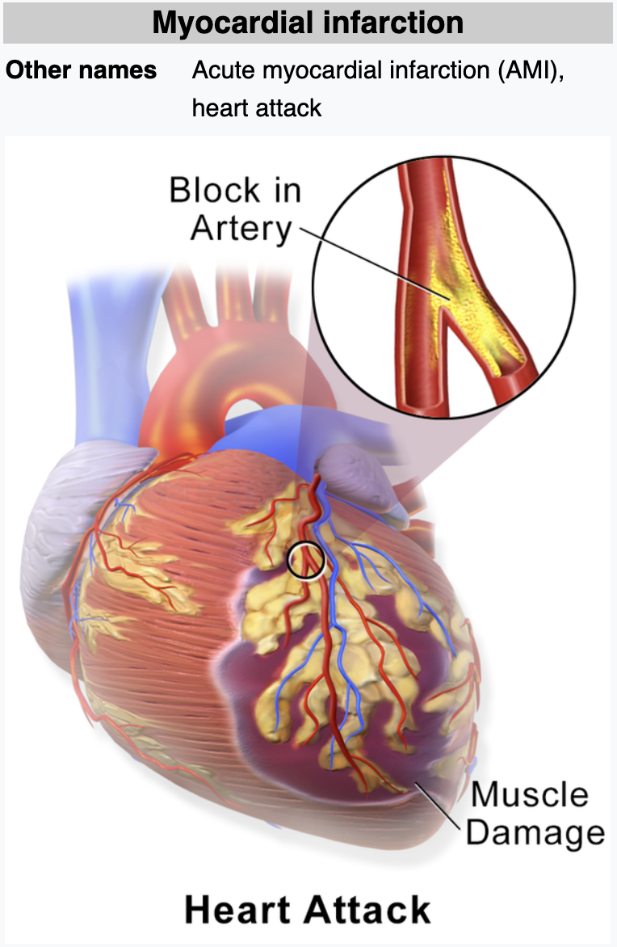
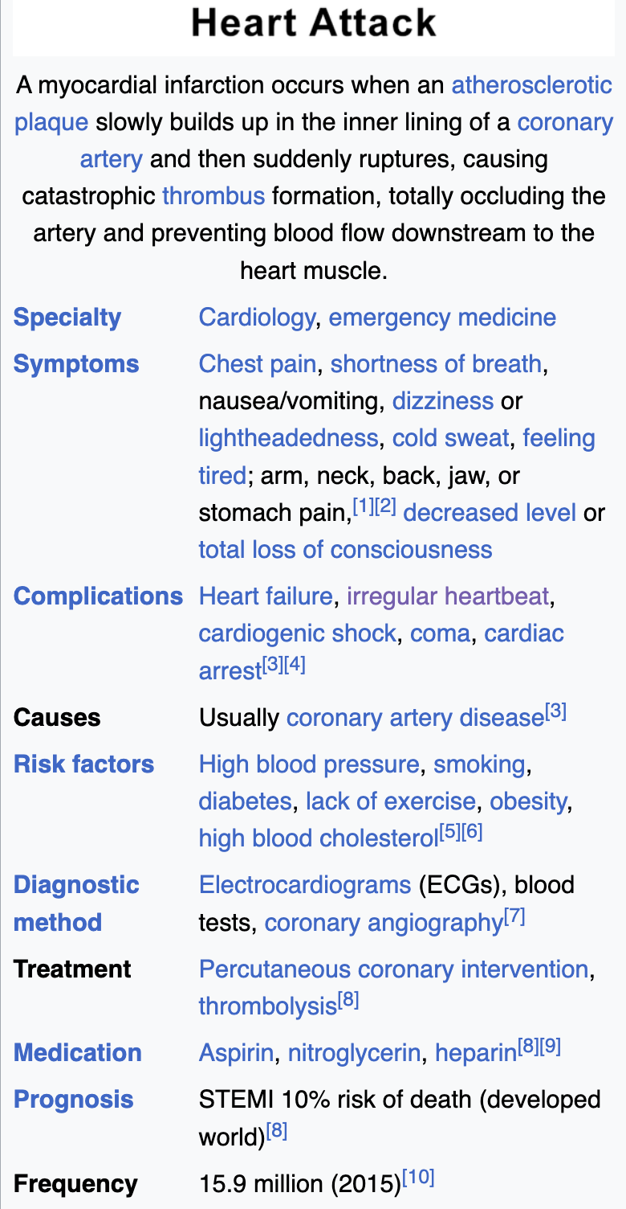
Introduction
Heart Attack -- Definition from the Wikipedia
Goal of Study:
- To explore the dataset through data analysis to identify attributes strongly associated with heart attacks
- To develop a predictive model using data mining techniques to accurately forecast the occurrence of heart attacks
https://en.wikipedia.org/wiki/Myocardial_infarction

Slide 3
Data Preprocessing
Heart.csv : 303 objects (302 distinct), 14 attributes
Numerical Data (5):
age [int.] : Age of the patient
trtbps [cont.] : resting blood pressure (in mmHg)
chol [cont.] : cholestoral in mg/dl fetched via BMI sensor
thalachh [int.] : maximum heart rate achieved
oldpeak [cont.] : ST depression induced by exercise relative to rest
Scaling
Categorical Data (9):
sex [cat.] : Sex of the patient (1 = male; 0 = female)
exng [cat.] : exercise induced angina (1 = yes; 0 = no)
ca [cat.]: number of major vessels (0-3)
cp [cat.] : Chest Pain type
fbs [cat.] : fasting blood sugar (> 120 mg/dl) (1 = true; 0 = false)
restecg [cat.] : resting electrocardiographic results
slp [cat.] : The slope of the peak exercise ST segment
thall [cat.] : Thal rate
output [cat.] : target (0= less chance of heart attack; 1= more chance of heart attack)
Factorization
Source: https://www.kaggle.com/datasets/rashikrahmanpritom/heart-attack-analysis-prediction-dataset/data

Slide 4
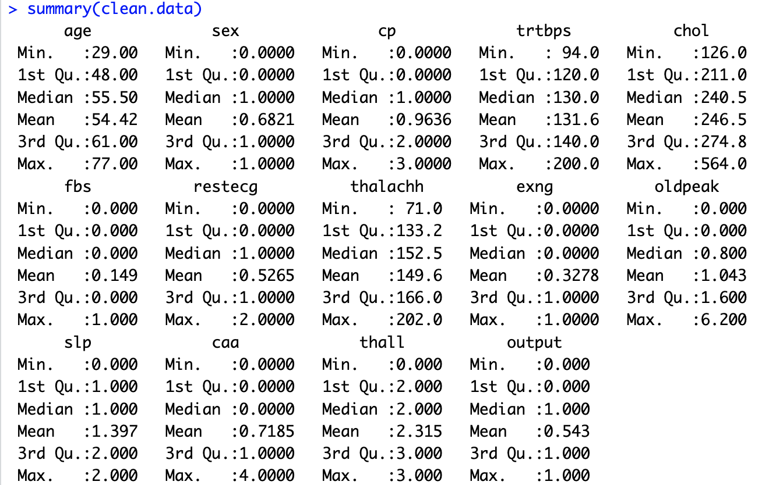
Exploratory Data Analysis (1) Summary Statistics

Slide 5
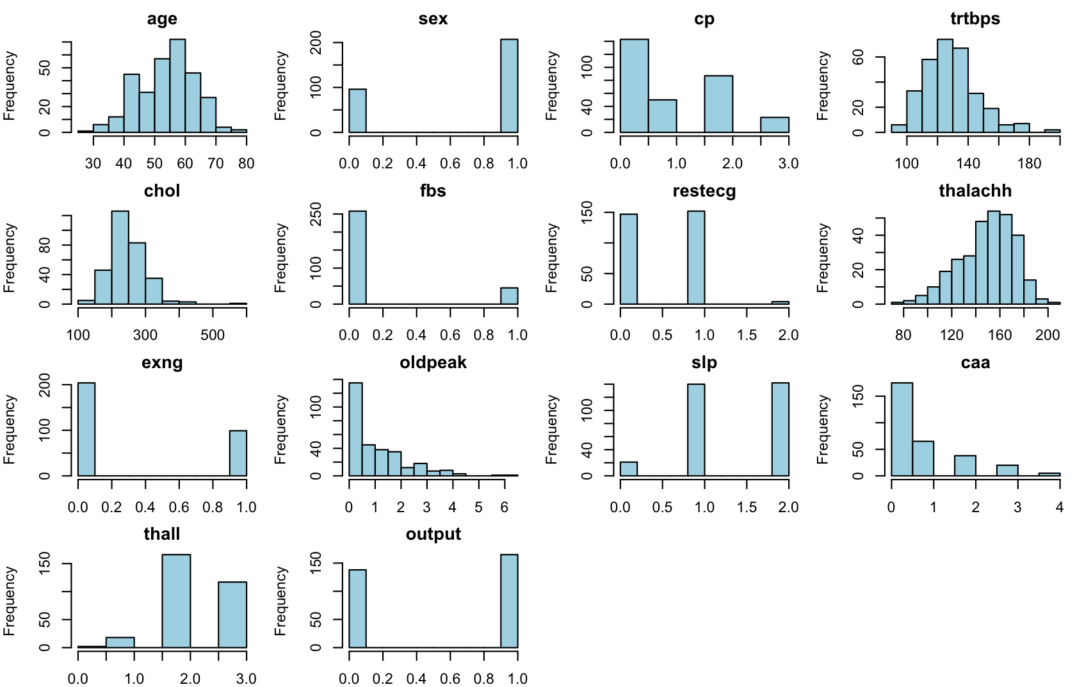
Exploratory Data Analysis (2) Univariate Analysis
Distribution of All Variables

Slide 6
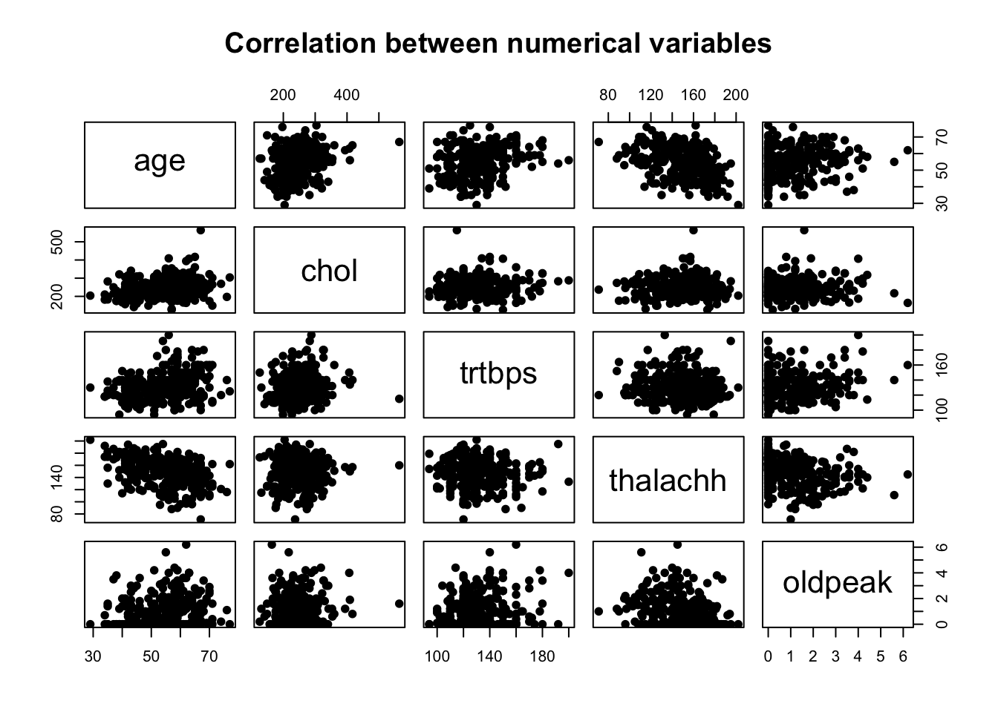
Exploratory Data Analysis (3) Bivariate Analysis of Numeric Variables
Notes:
There are no strong correlation between numerical attributes

Slide 7
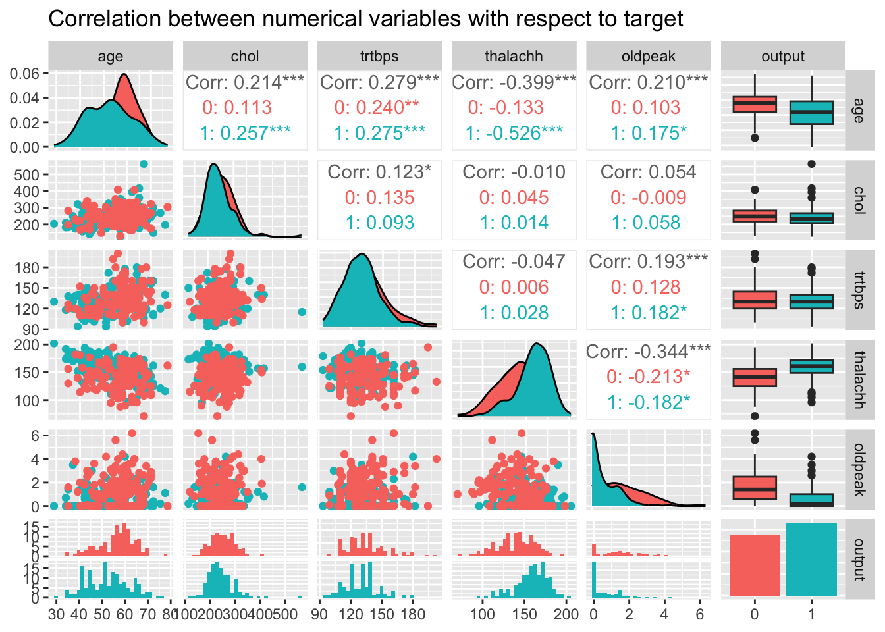
Exploratory Data Analysis (3) Bivariate Analysis of Numeric Variables
Notes:
There are no strong correlation between numerical attributes nor with the output.

Slide 8
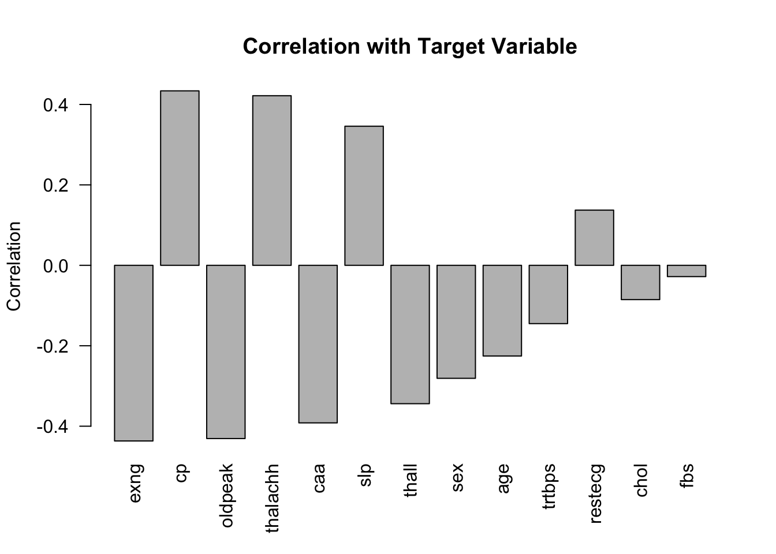
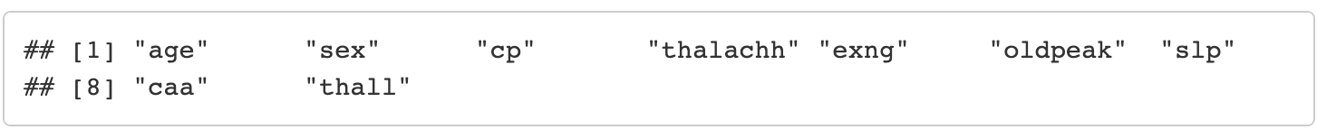
Exploratory Data Analysis (4) Correlation with Target Variable
Correlation from 9 variables that exceeds threshold (0.2):
Notes:
There are no strong correlation between numerical attributes nor with the output.

Slide 9
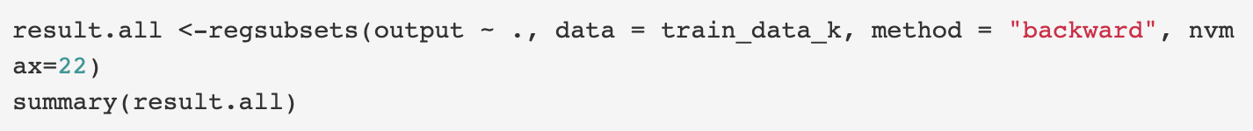
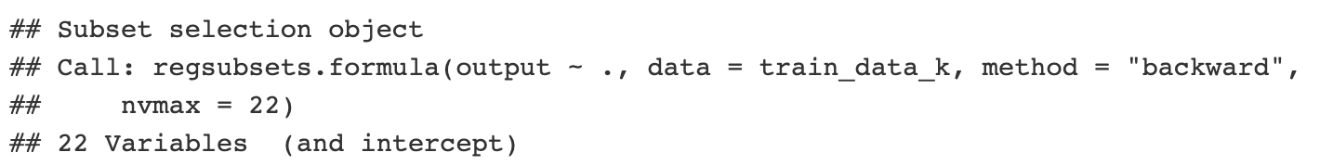
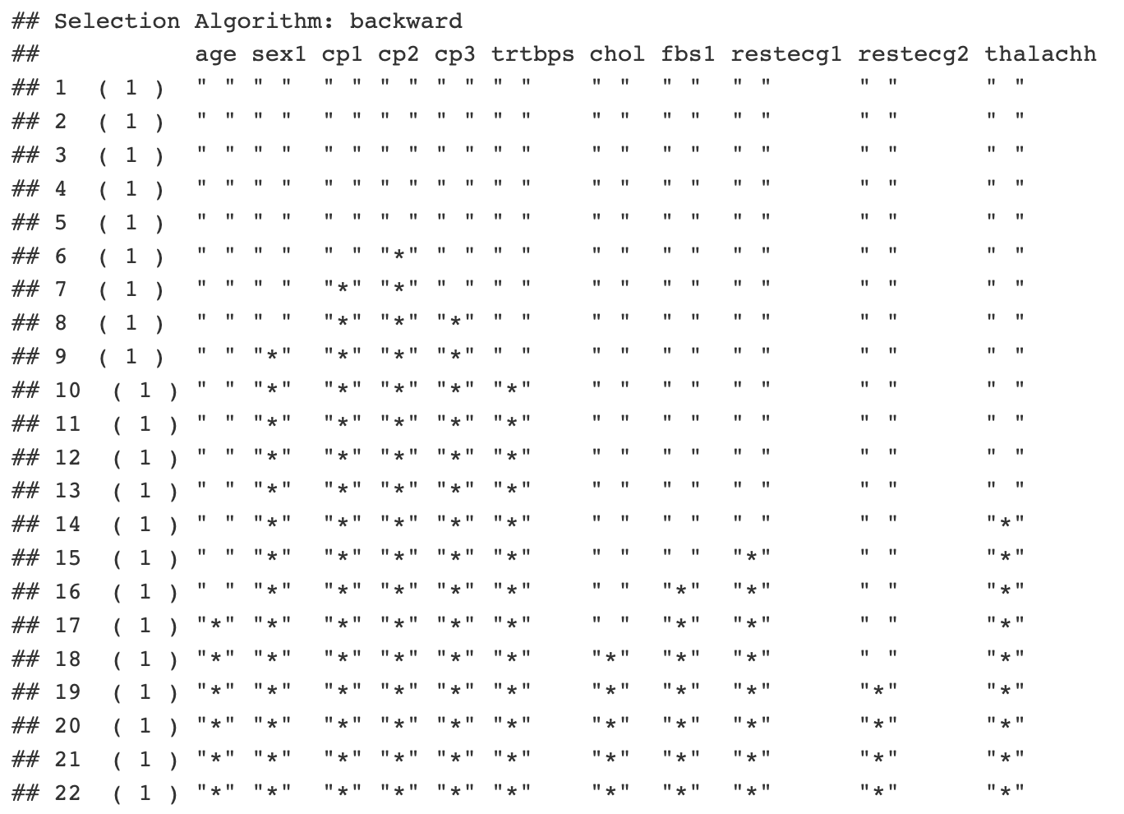
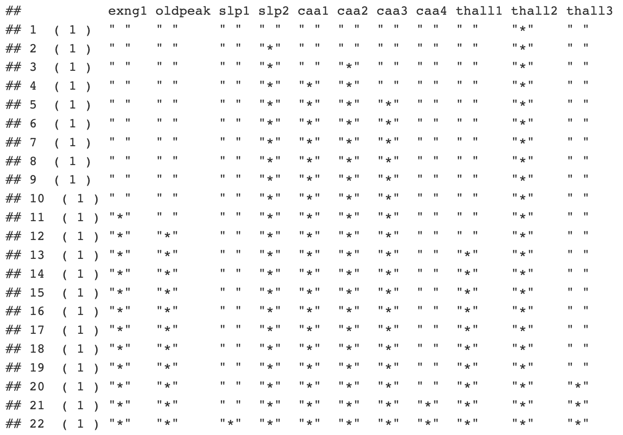
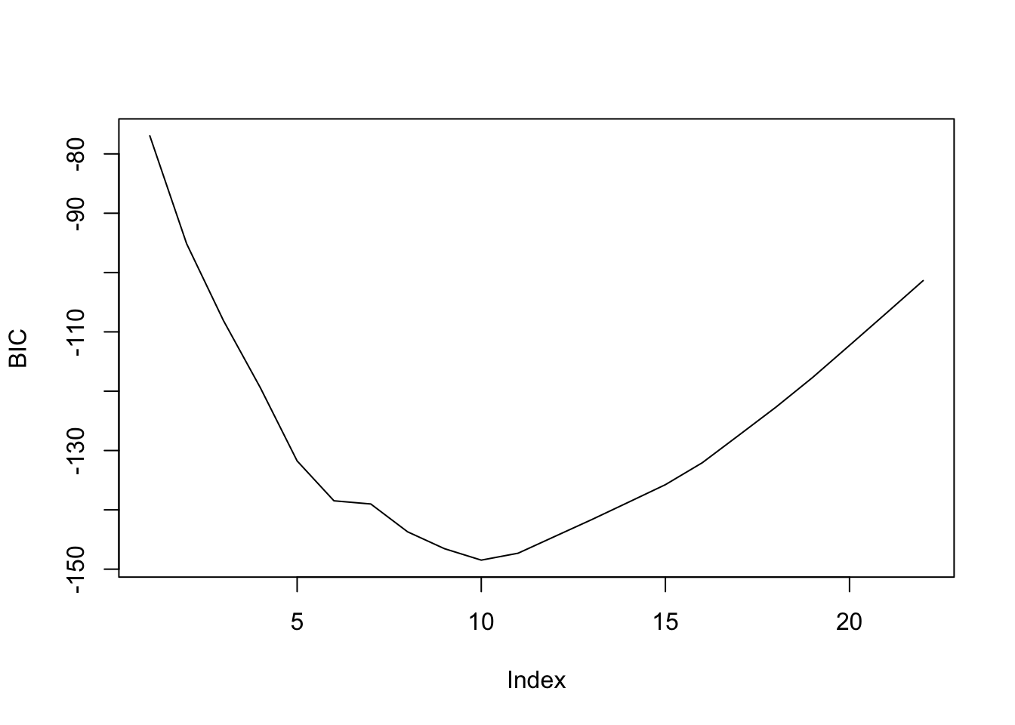
Exploratory Data Analysis (5) Subset selection (Backward/BIC)
Backward selection to find the best subset
BIC plot to find the proper size of subset
BIC vs. Subset Size
Subset of 10 includes factorized variables, which only belong to 6 distinct variables.
Subset of 6 variables selected: (sex, cp, trtbps, slp, caa, thall)

Slide 10
Exploratory Data Analysis (6) Summary
Correlation between numerical variables are not strong;
There is no clear distinction among the numerical variables with respect to the target;
Correlation between predictors and target variable suggests a subset of 9 variables:
(age + sex + exng + caa + cp + thalachh + slp + oldpeak + thall)
Backward subset selection suggests that a subset of 6 could be proper:
(sex + cp + trtbps + slp + caa + thall)
We will also try to build models with all predictors and see their effect.
Notes:
There are no strong correlation between numerical attributes nor with the output.

Slide 11
Modeling Techniques (1) Methodology
Algorithms | # Predictors | Other Details | Cross-Validation
KNN | All, 9, 6 | method = “knn” k (#nearest neighbors) = 1:16; preProcess = “scale” | 10 folds
Decision Tree | All, 9, 6 | method = “rpart” | 10 folds
SVM | All, 9, 6 | method = “svmLinear” | 10 folds
Naïve Bayes | All, reduced set | method = “nb” fL = 1:5, usekernal = c(TRUE,FALSE), adjust = 1:3 | 10 folds
Logistic Regression | All, 9, 6 | family = “binominal” | -
Notes:
Choose a Suitable Algorithm: Select an appropriate data mining algorithm based on the problem at hand, the characteristics of the dataset, and your goals. Some algorithms that can handle mixed attribute types include decision trees, random forests, Naive Bayes classifiers, and ensemble methods like Gradient Boosting and AdaBoost.
Train the Model: Split the dataset into training and testing sets. Use the training set to train the chosen model on the data.
Evaluate the Model: Use the testing set to evaluate the performance of the trained model. Calculate appropriate evaluation metrics such as accuracy, precision, recall, F1-score, or area under the ROC curve (AUC-ROC) based on the problem type.

Slide 12
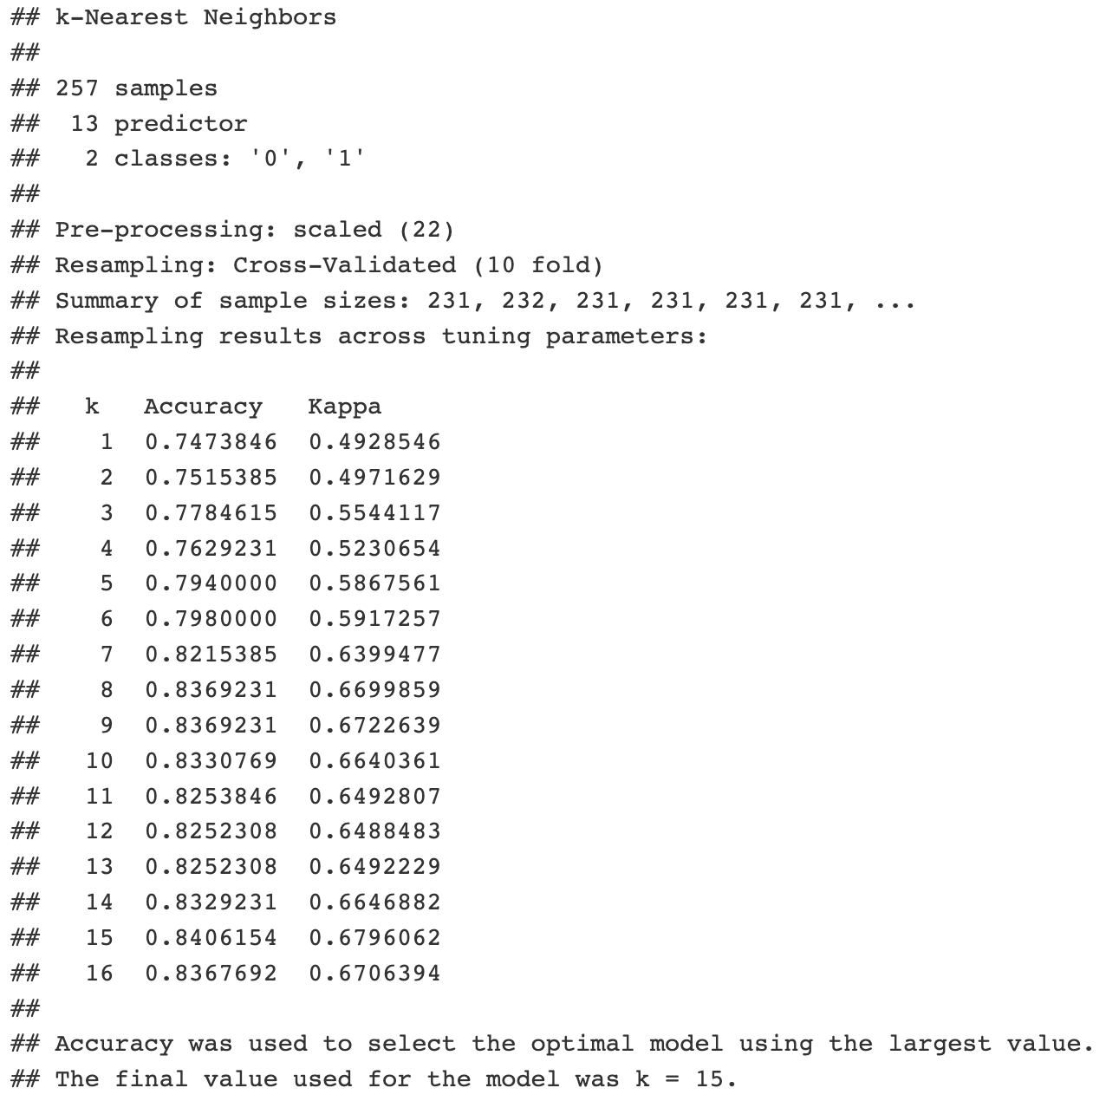
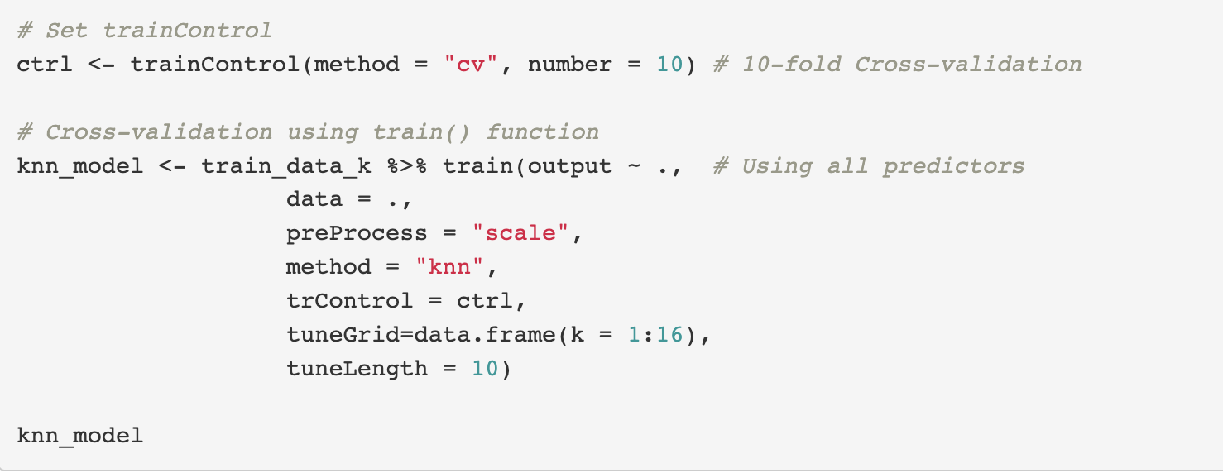
KNN
Modeling Techniques (2) Model Training
(1) Model with all predictors (KNN)
k Accuracy Kappa
15 0.84062 0.67961
Notes:
Train the Model: Split the dataset into training and testing sets. Use the training set to train the chosen model on the data.

Slide 13
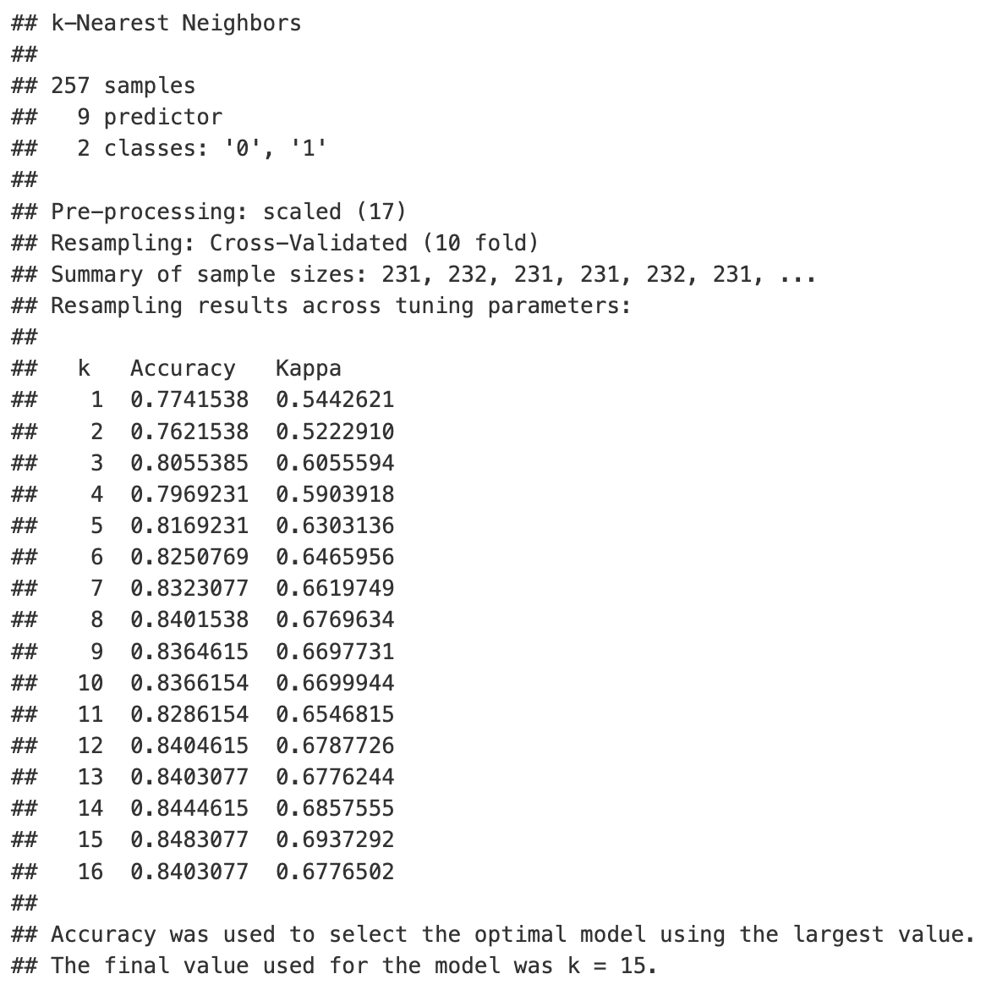
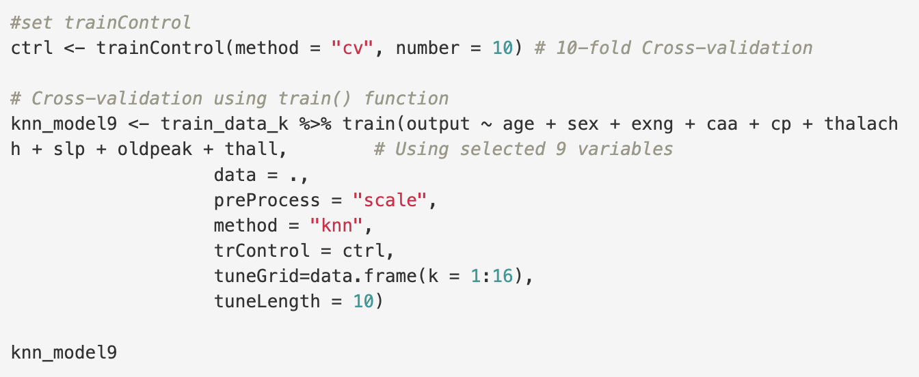
KNN
Modeling Techniques (2) Model Training
(2) Model with 9 predictors (KNN9)
k Accuracy Kappa
15 0.84831 0.69373
Notes:
Train the Model: Split the dataset into training and testing sets. Use the training set to train the chosen model on the data.

Slide 14
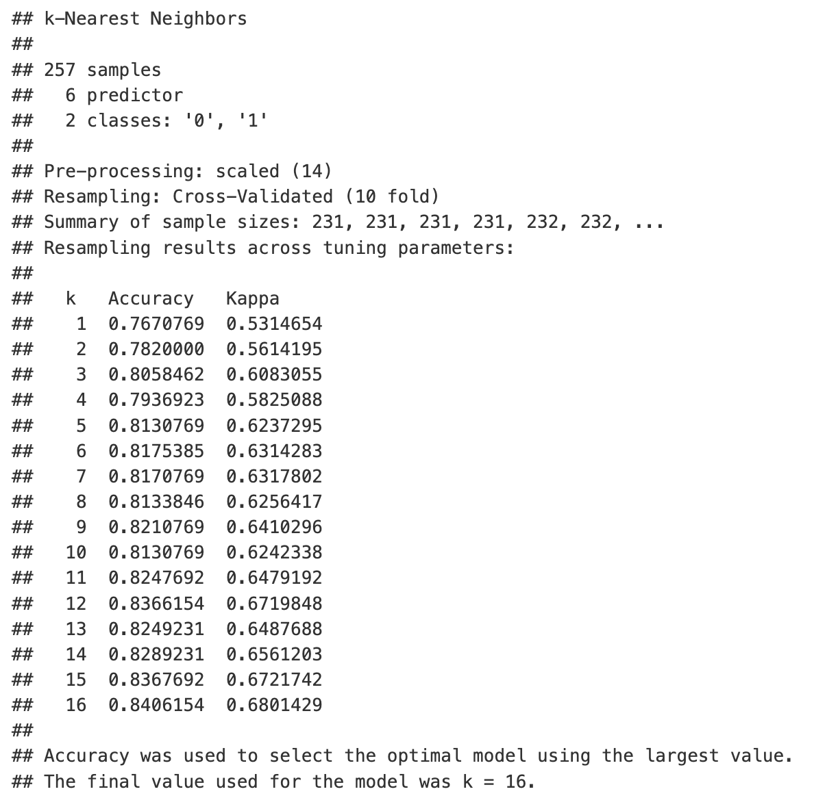
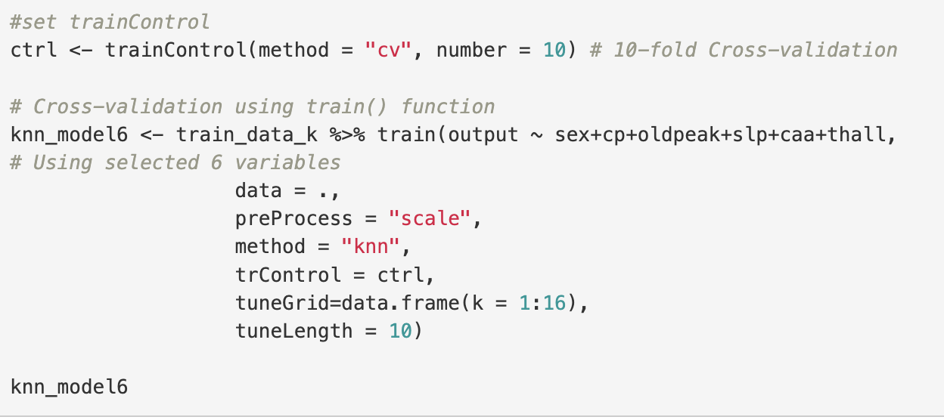
KNN
Modeling Techniques (2) Model Training
(3) Model with 6 predictors (KNN6)
k Accuracy Kappa
16 0.84062 0.68014
Notes:
Train the Model: Split the dataset into training and testing sets. Use the training set to train the chosen model on the data.

Slide 15
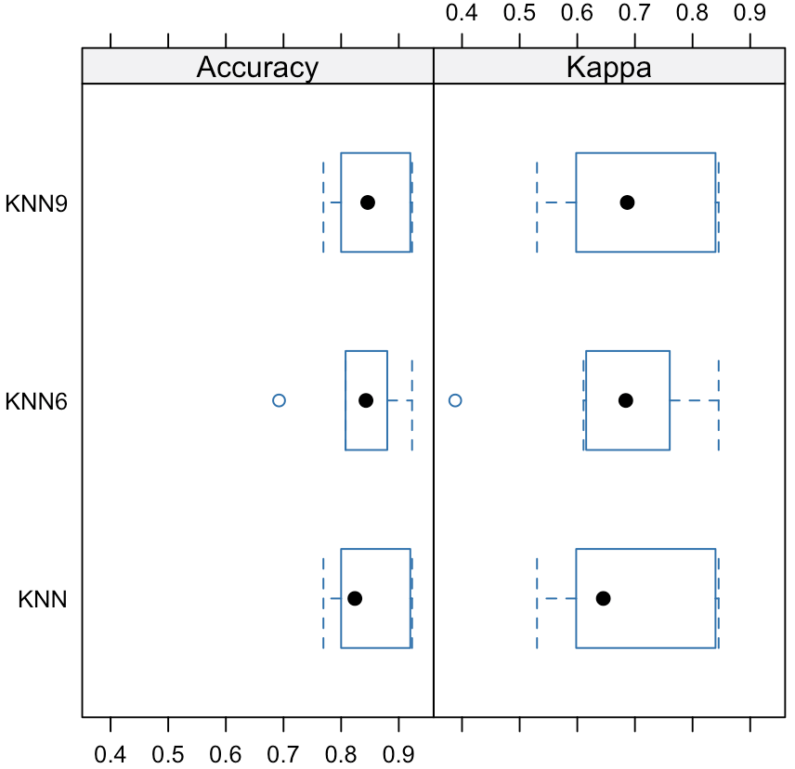
KNN
Modeling Techniques (3) Model Evaluation
Comparison of three KNN models:
Model | K | Accuracy | Kappa
KNN | 15 | 0.84062 | 0.67961
KNN9 | 15 | 0.84831 | 0.69373
KNN6 | 16 | 0.84062 | 0.68014
Notes:
Train the Model: Split the dataset into training and testing sets. Use the training set to train the chosen model on the data.

Slide 16
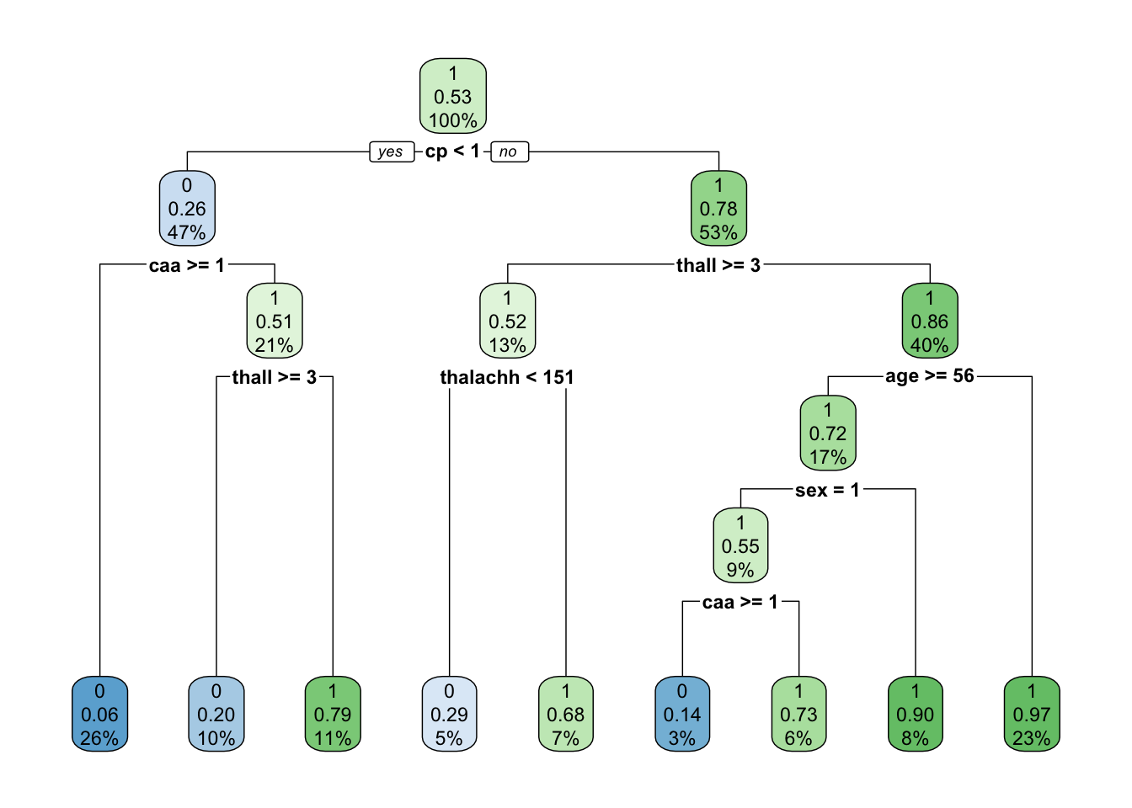
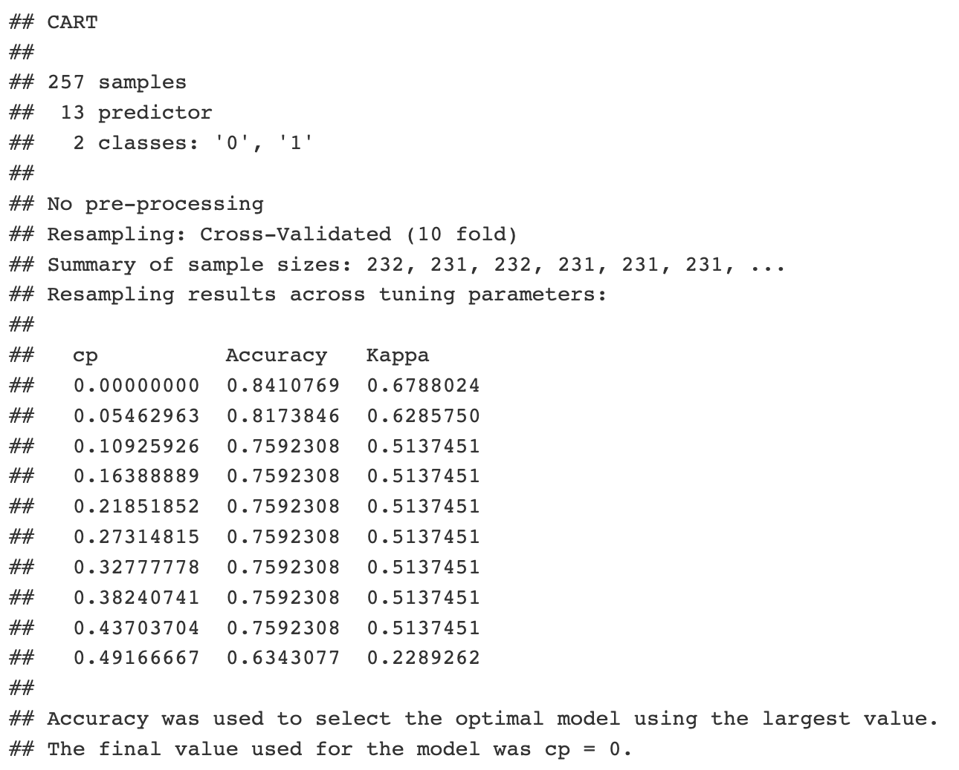
Decision Tree
Modeling Techniques (2) Model Training
(1) Model with all predictors (DT)
Accuracy Kappa
0.84108 0.67880
Notes:
Train the Model: Split the dataset into training and testing sets. Use the training set to train the chosen model on the data.

Slide 17
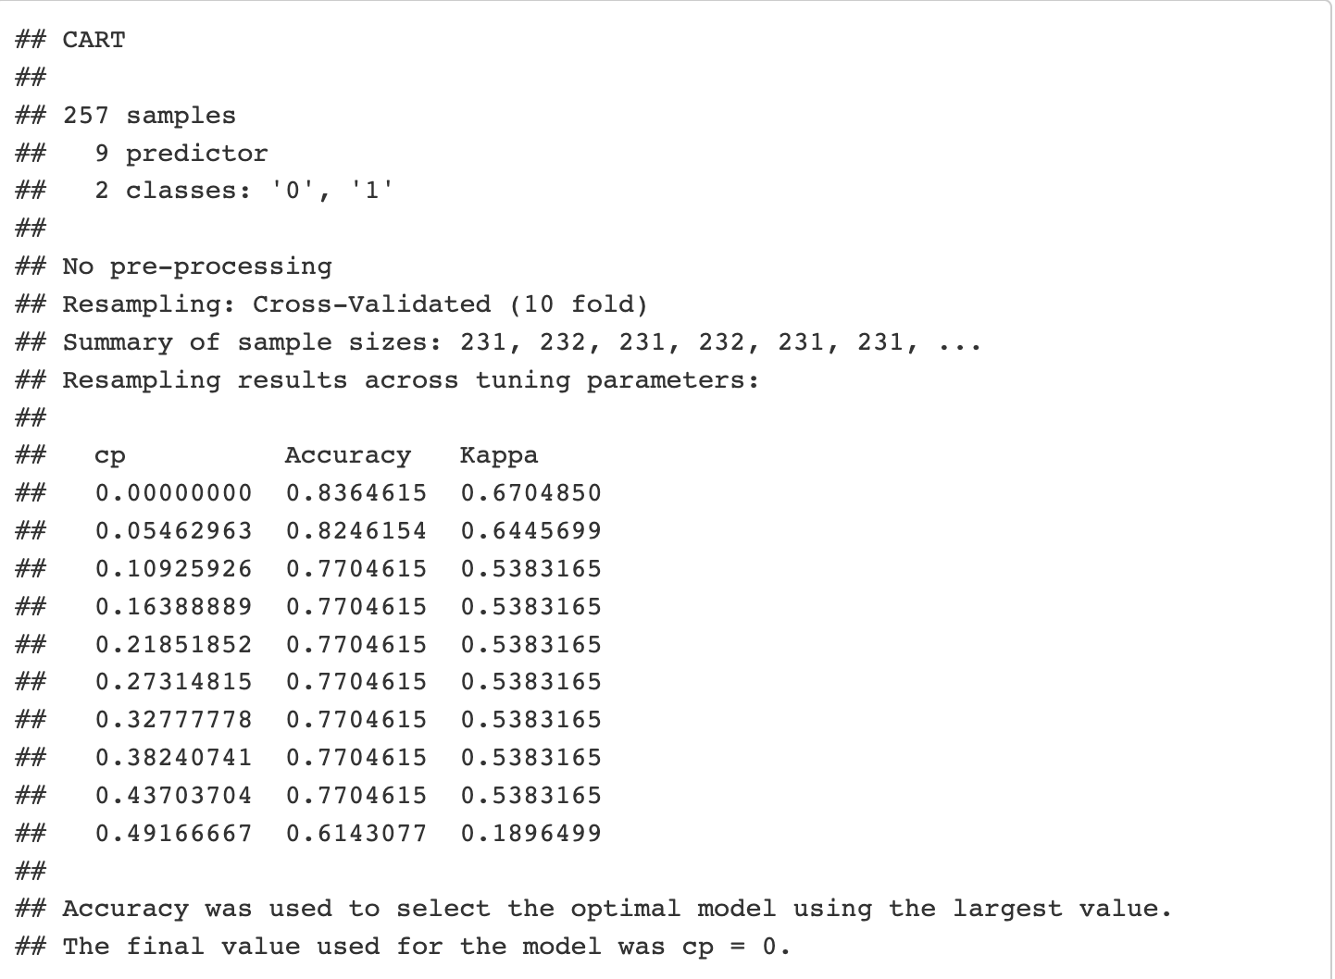
Decision Tree
Modeling Techniques (2) Model Training
(2) Model with 9 predictors (DT9)
Accuracy Kappa
0.83646 0.67049
Notes:
Train the Model: Split the dataset into training and testing sets. Use the training set to train the chosen model on the data.

Slide 18
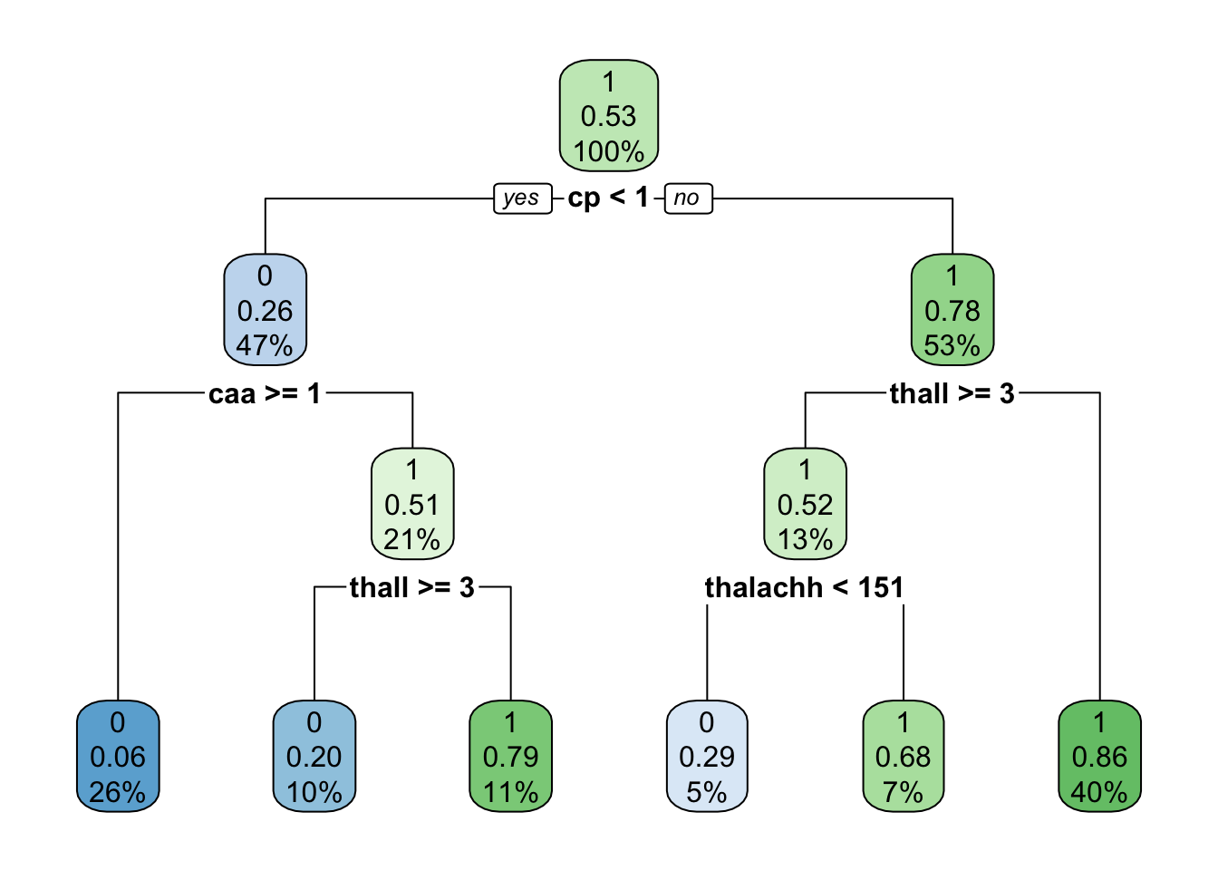
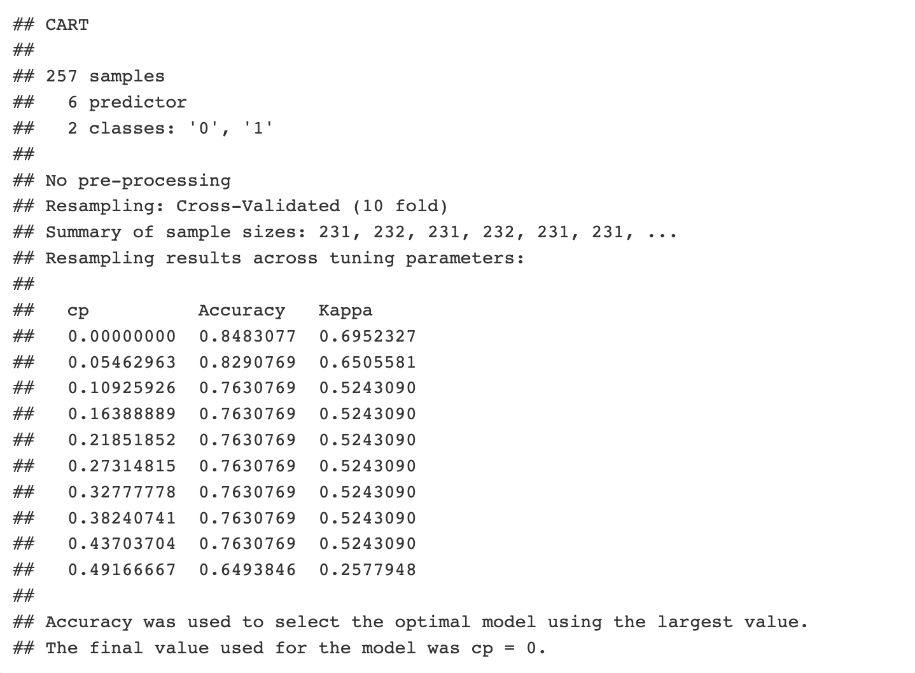
Decision Tree
Modeling Techniques (2) Model Training
(3) Model with 6 predictors (suggested by subset selection) (DT6)
Accuracy Kappa
0.84831 0.69523
Notes:
Train the Model: Split the dataset into training and testing sets. Use the training set to train the chosen model on the data.

Slide 19
Decision Tree
Modeling Techniques (2) Model Training
(4) Model with 6 predictors (chosen from first tree model) (DT6_2)
Accuracy Kappa
0.84108 0.67880
Notes:
Train the Model: Split the dataset into training and testing sets. Use the training set to train the chosen model on the data.

Slide 20
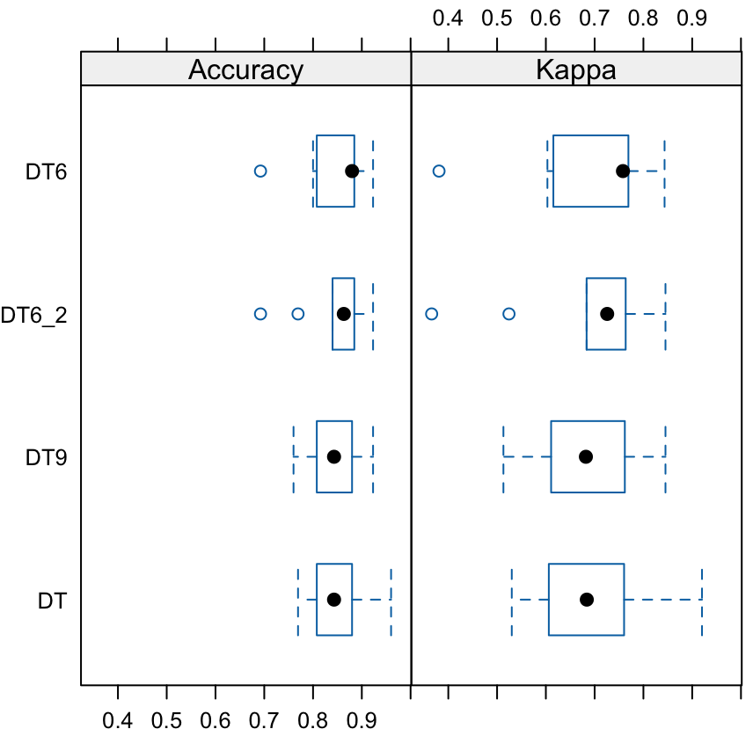
Decision Tree
Modeling Techniques (3) Model Evaluation
Comparison of four Decision Tree models:
Model | Accuracy | Kappa
DT | 0.84108 | 0.67880
DT9 | 0.83646 | 0.67049
DT6 | 0.84831 | 0.69523
DT6_2 | 0.84108 | 0.67880
Notes:
Train the Model: Split the dataset into training and testing sets. Use the training set to train the chosen model on the data.

Slide 21
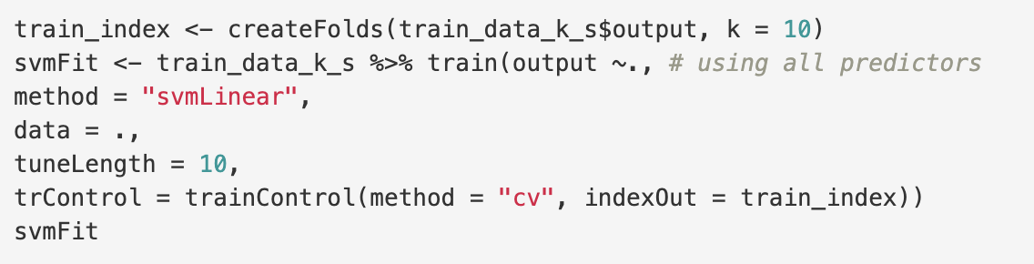
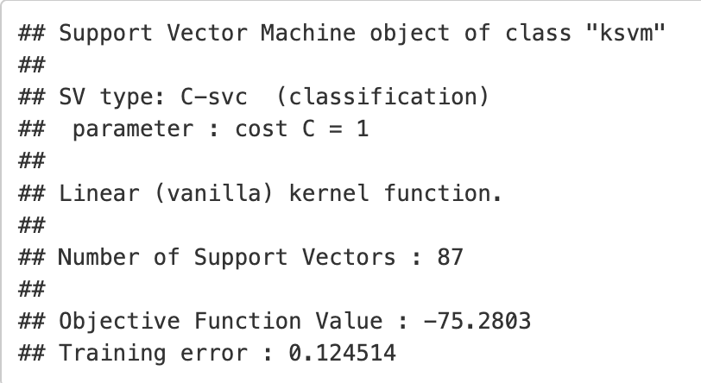
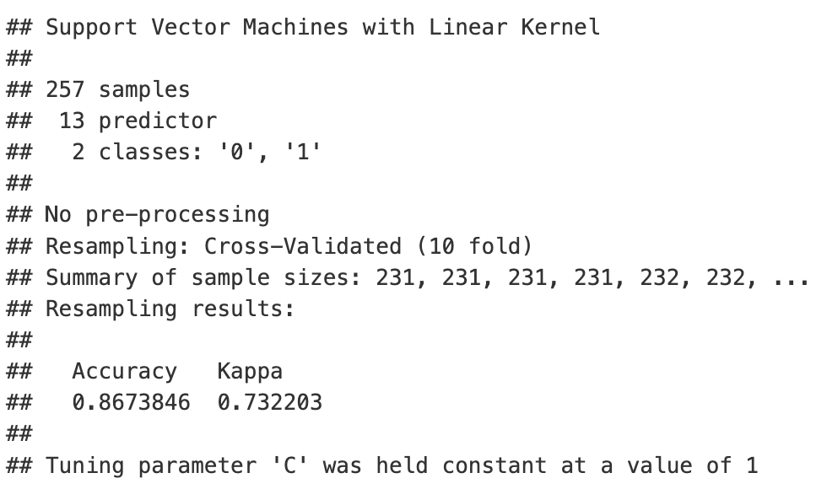
SVM
Modeling Techniques (2) Model Training
(1) Model with all predictors (SVM)
Accuracy Kappa
0.86738 0.73220
Notes:
Train the Model: Split the dataset into training and testing sets. Use the training set to train the chosen model on the data.

Slide 22
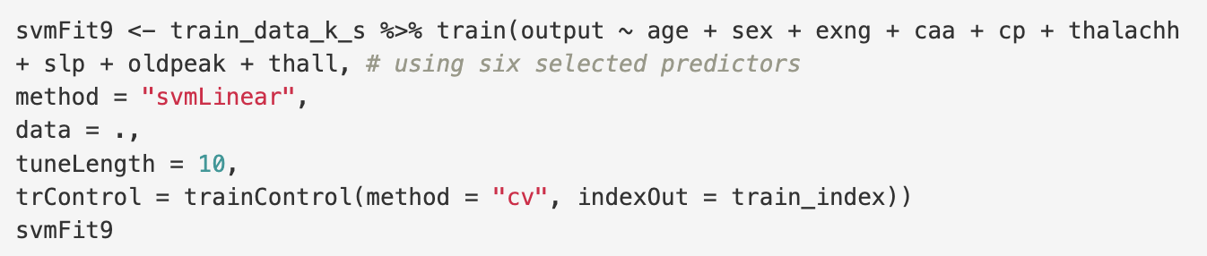
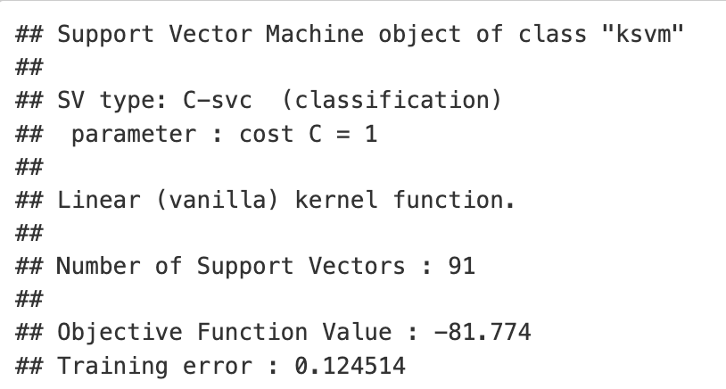
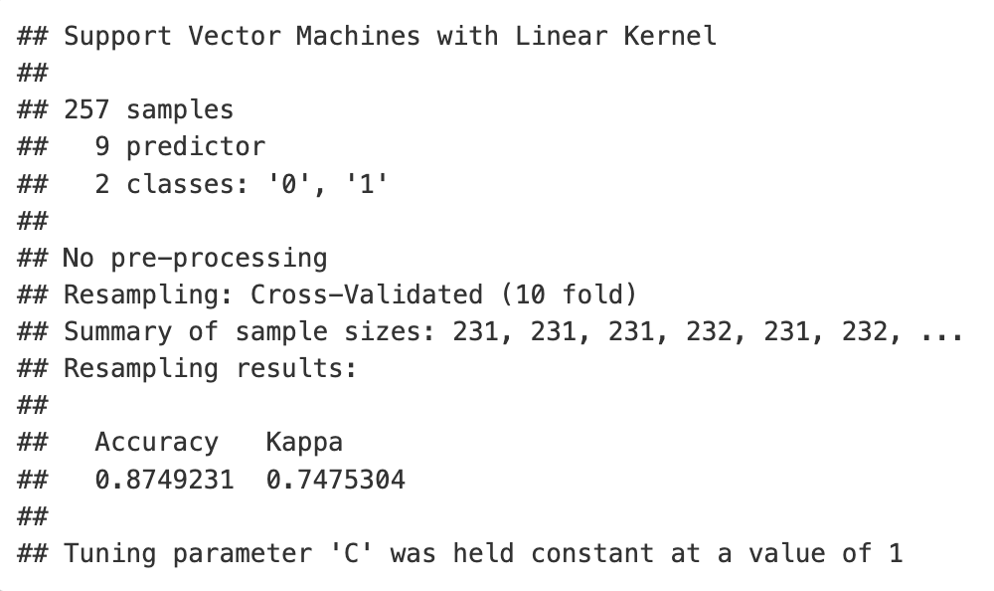
SVM
Modeling Techniques (2) Model Training
(2) Model with nine predictors (SVM9)
Accuracy Kappa
0.87492 0.74753
Notes:
Train the Model: Split the dataset into training and testing sets. Use the training set to train the chosen model on the data.

Slide 23
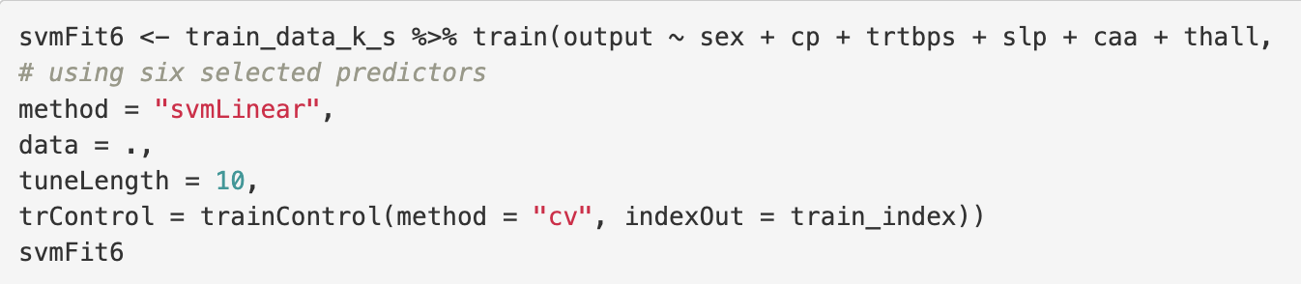
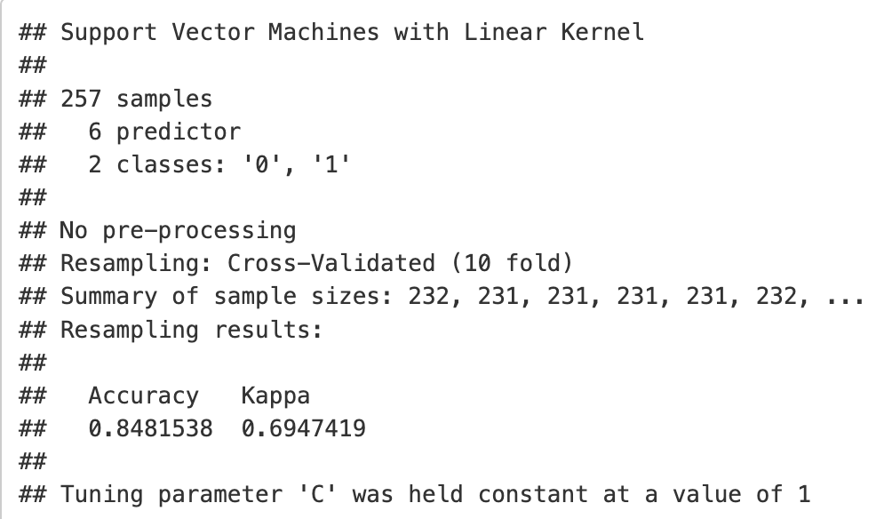
SVM
Modeling Techniques (2) Model Training
(3) Model with six predictors (SVM6)
Accuracy Kappa
0.84815 0.69474
Notes:
Train the Model: Split the dataset into training and testing sets. Use the training set to train the chosen model on the data.

Slide 24
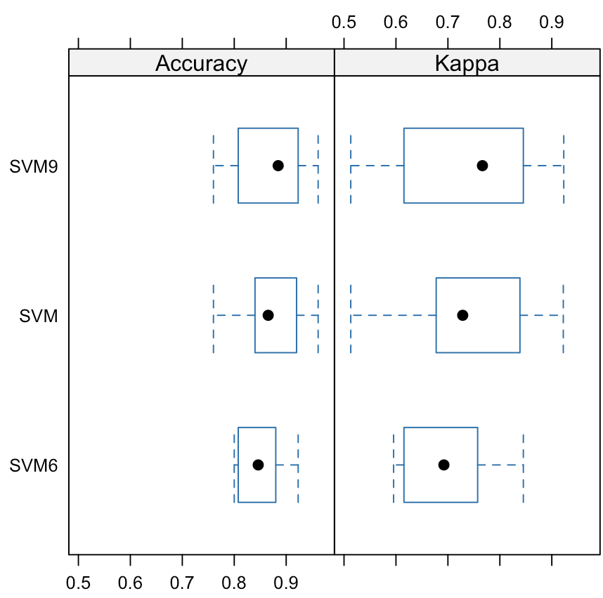
SVM
Modeling Techniques (3) Model Evaluation
Comparison of three SVM models:
Model | Accuracy | Kappa
SVM | 0.86738 | 0.73220
SVM9 | 0.87492 | 0.74753
SVM6 | 0.84815 | 0.69474
Notes:
Train the Model: Split the dataset into training and testing sets. Use the training set to train the chosen model on the data.

Slide 25
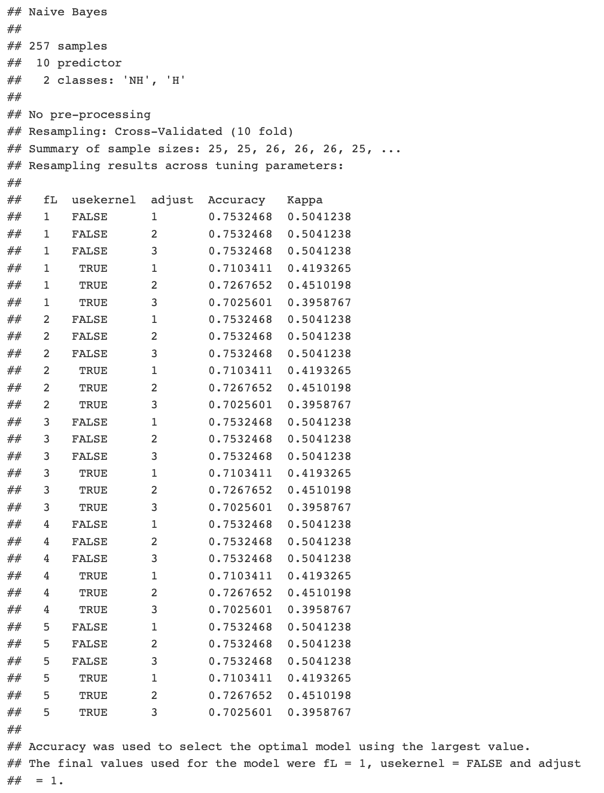
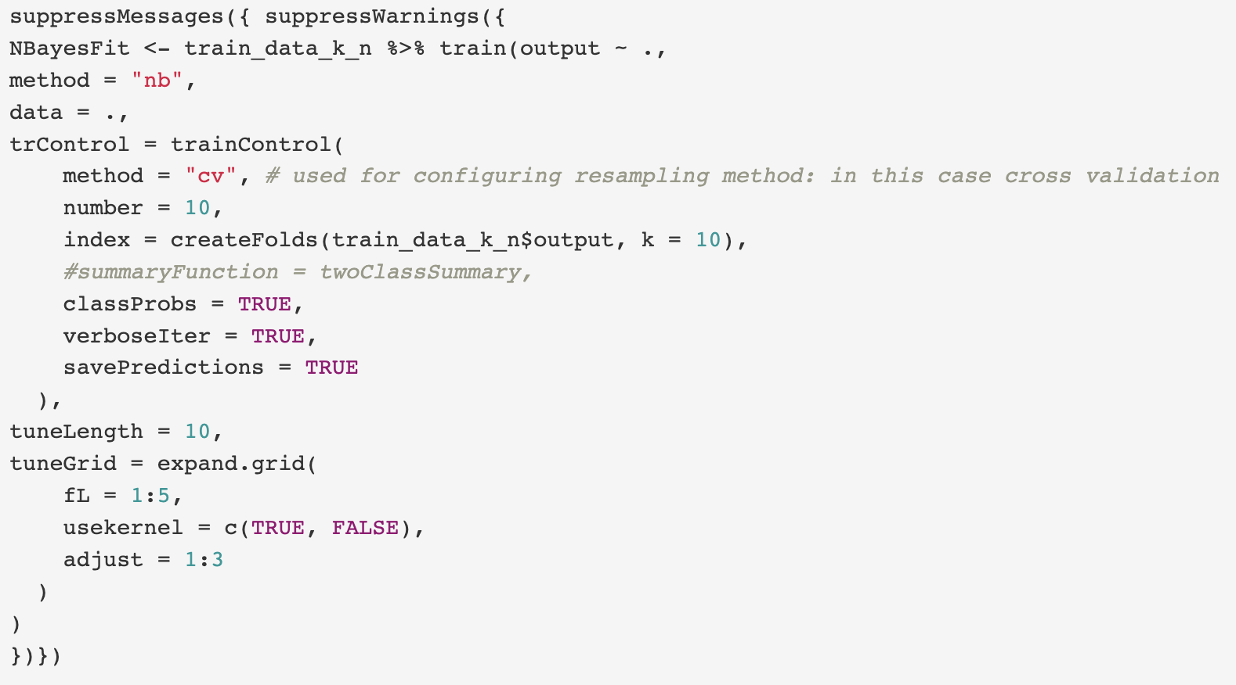
Naïve Bayes
Modeling Techniques (2) Model Training
Model with all predictors
[excluding (‘restecg’, ‘caa’, ‘thall’) ]
(Notes on dropping nominal variables with rare levels:
We have tried fitting into all feature in initial attempt of Naive Bayes Classifier. However, the training set does not contain observations for all values in some nominal variables. They are 'restecg', 'caa' and 'thall'. And we got error messages, indicating that each of the variables have a very rare level (or more), in such case, the three variables are dropped.)
Notes:
Train the Model: Split the dataset into training and testing sets. Use the training set to train the chosen model on the data.

Slide 26
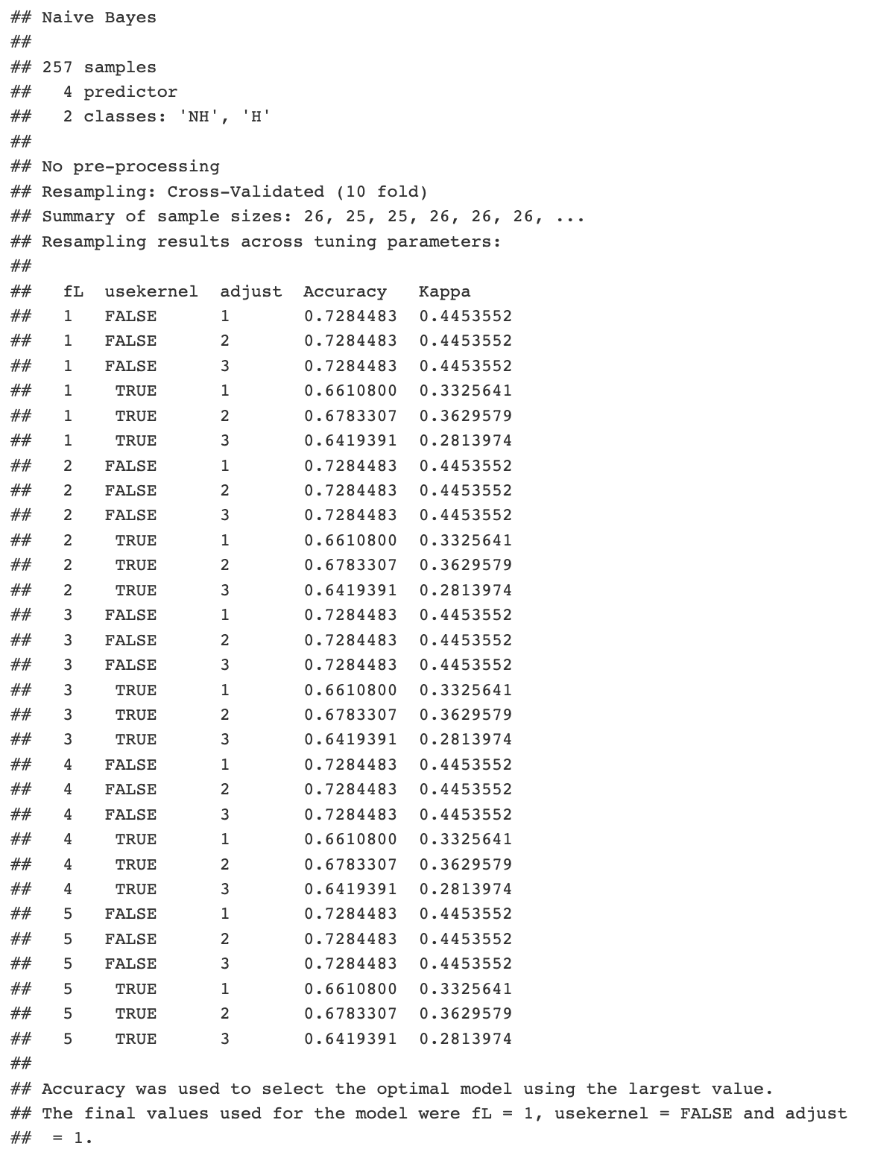
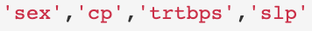
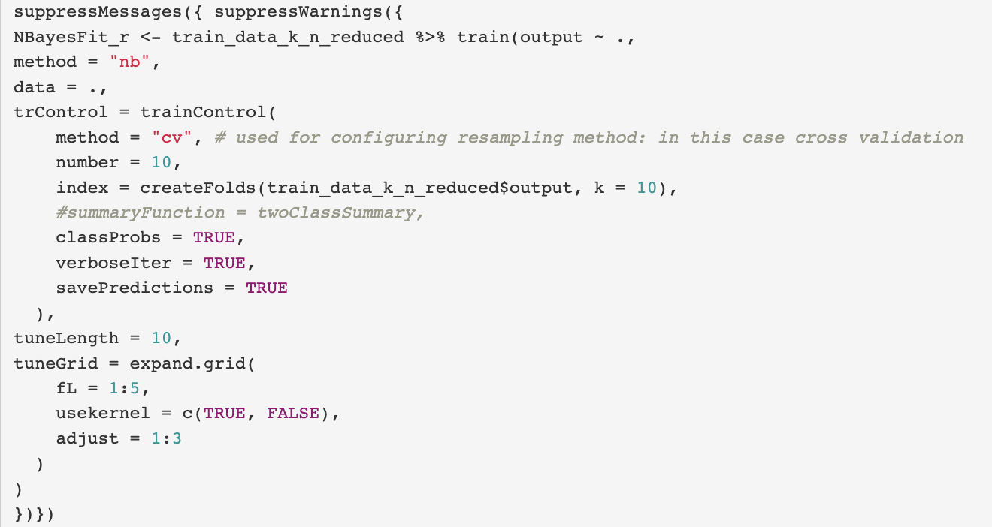
Naïve Bayes
Modeling Techniques (2) Model Training
(2) Model with 6 predictors
[excluding (‘restecg’, ‘caa’, ‘thall’)]
(Notes on dropping nominal variables with rare levels:
We have tried fitting into all feature in initial attempt of Naive Bayes Classifier. However, the training set does not contain observations for all values in some nominal variables. They are 'restecg', 'caa' and 'thall'. And we got error messages, indicating that each of the variables have a very rare level (or more), in such case, the three variables are dropped.)
Notes:
Train the Model: Split the dataset into training and testing sets. Use the training set to train the chosen model on the data.

Slide 27
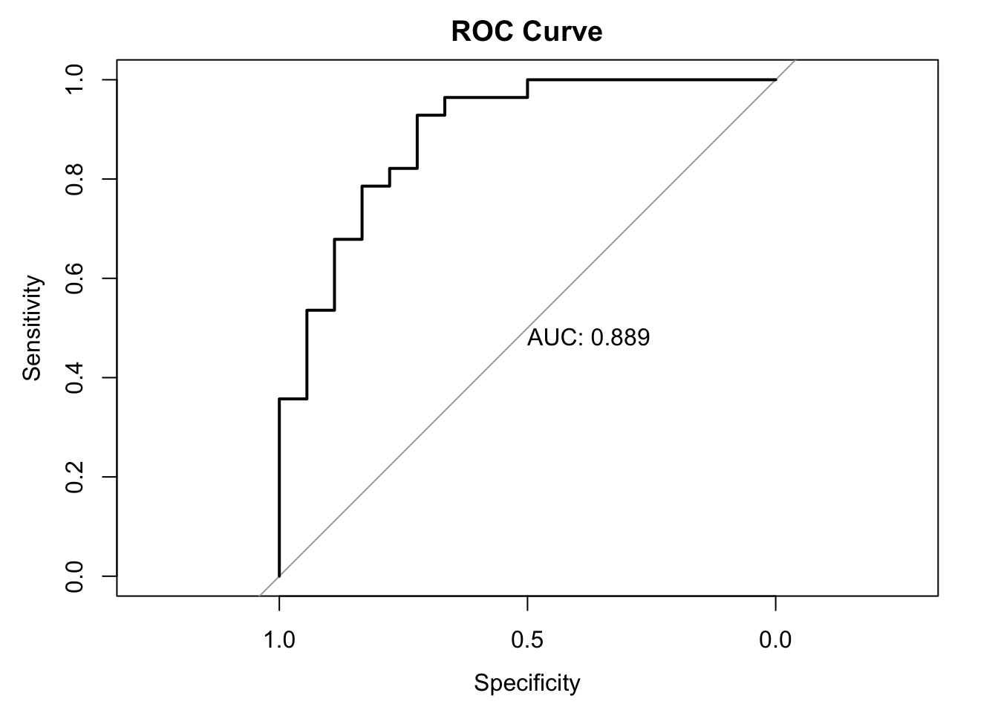
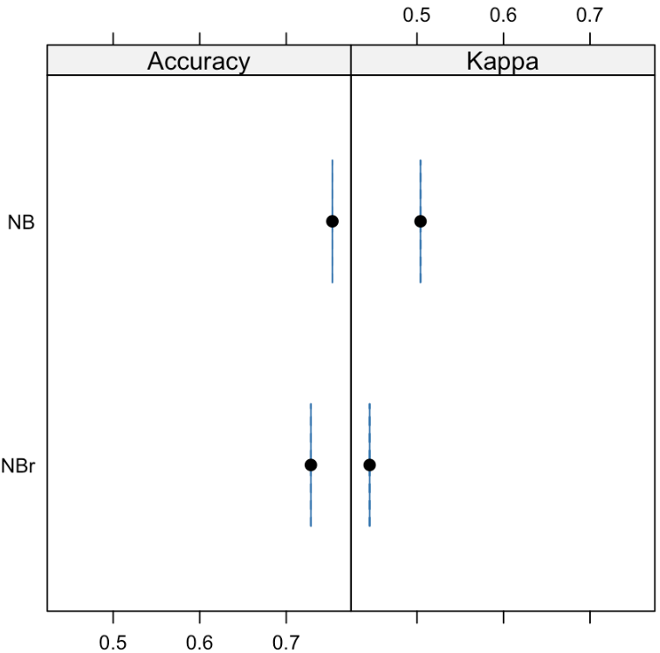
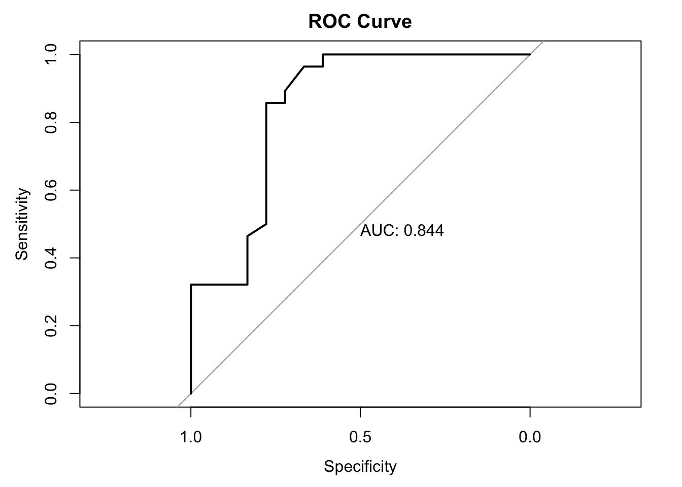
Naïve Bayes
Modeling Techniques (3) Model Evaluation
Model | Accuracy | Kappa
NB | 0.75325 | 0.50412
NBr | 0.72845 | 0.44536
Notes:
Train each candidate model on the training set using appropriate hyperparameters and model configurations.
Evaluate the performance of each model on the testing set using the selected evaluation metrics. This helps you assess how well each model generalizes to unseen data.
Choose appropriate evaluation metrics based on the nature of the problem.
For classification tasks, common metrics include accuracy, precision, recall, F1-score, and area under the ROC curve (AUC-ROC).
For regression tasks, metrics such as mean squared error (MSE), mean absolute error (MAE), and R-squared can be used.

Slide 28
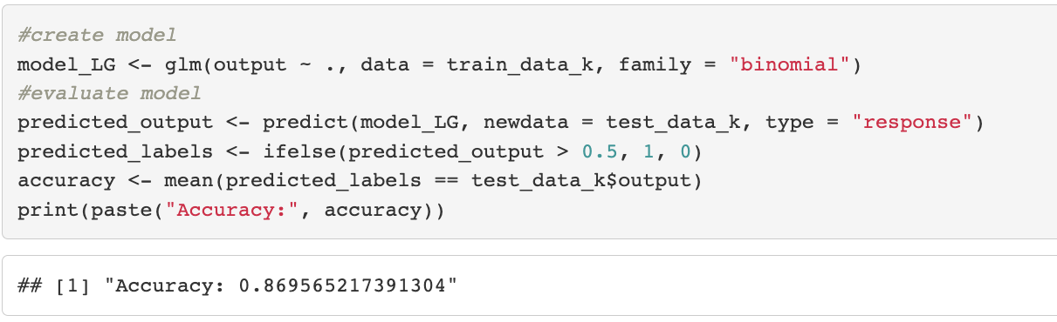
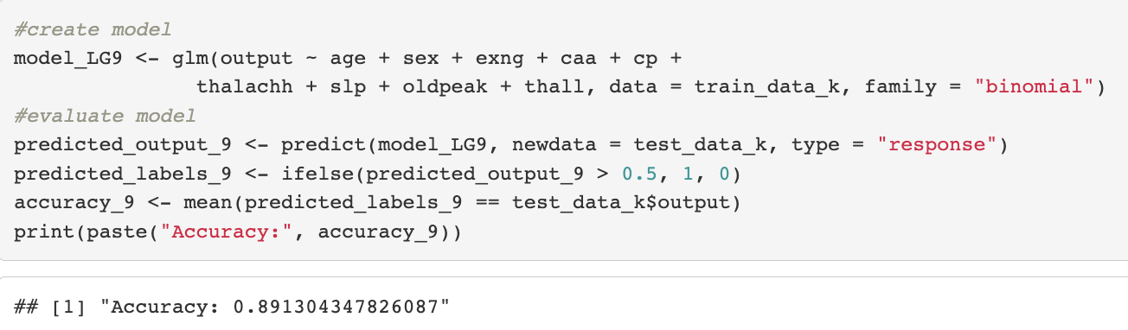
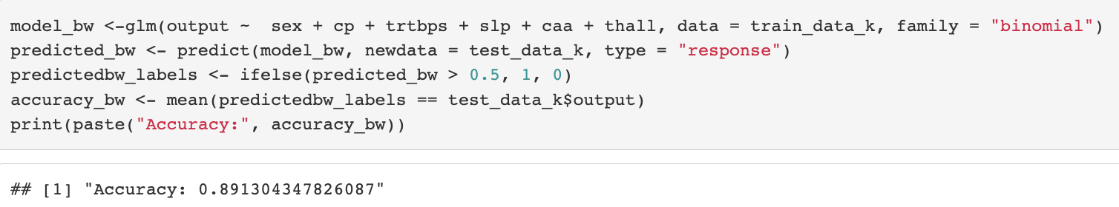
Logistic Regression
Modeling Techniques (2) Model Training
(1) Model with all predictors (LR)
(2) Model with nine predictors (LR9)
(3) Model with six predictors (LR6)
(Note: ANOVA can be added to further evaluate the regression models.)
Notes:
Train the Model: Split the dataset into training and testing sets. Use the training set to train the chosen model on the data.

Slide 29
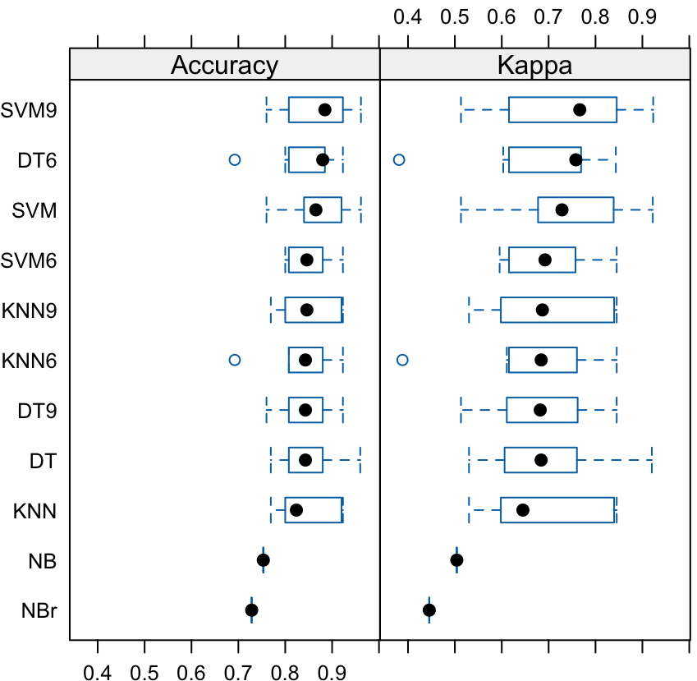
Model Comparison
Among the classifiers, SVM using 9 selected features work best;
On the other hand, Logistics Regression using 6 selected features also work well.
We put them both to Test Data to decide which is our FINAL SELECTED MODEL.
Notes:
Compare the performance of different models based on the evaluation metrics. Consider both the overall performance and the specific requirements of your problem. For example, if interpretability is important, you may prefer a simpler model even if its performance is slightly lower.
Based on the performance comparison, select one or a few models that exhibit better performance on the evaluation metrics and align with your goals and requirements. These models are considered promising candidates.

Slide 30
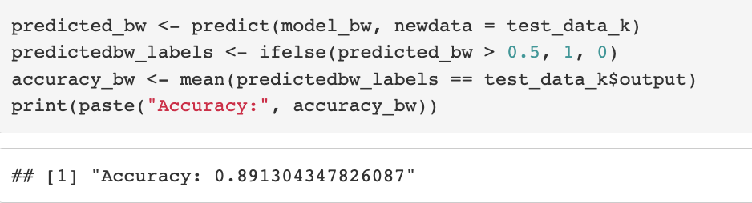
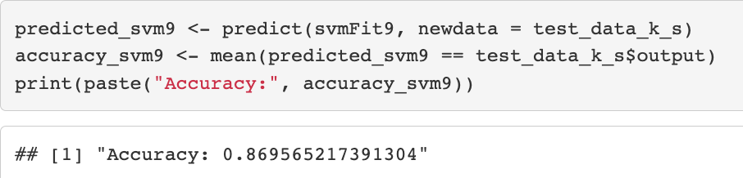
Final Model Validation
(1) SVM using 9 selected features
(2) Logistics Regression with 6 selected features
Notes:
Take the selected promising models and validate them using a separate validation dataset or cross-validation. This step helps to assess the final model's generalization performance and ensure that it performs well on unseen data.

Slide 31
Conclusion
Among 13 variables, we selected 2 subsets for model building based on:
(1) Correlation with target variable (9 selected)
(2) Backward subset selection (6 selected)
We tried both classification and regression methods on selected predictors to build prediction models, validated each model with cross-validation, and compared them by accuracy and kappa values. Methods including:
Classification: KNN, Decision Tree, SVM, Naïve Bayes
Regression: Logistic regression
We shortlisted two best candidates: (1) SVM with 9 selected features, and (2) Logistics Regression with 6 selected features.
Finally, we tested the two finalists on the test data and found Logistics Regression with 6 selected features gives the best prediction.

Slide 32
Thank you
Q & A

Slide 33
Appendix I: Dataset description
Heart.csv : 303 objects, 14 attributes
age [int.] : Age of the patient
sex [cat.] : Sex of the patient (1 = male; 0 = female)
exng [cat.] : exercise induced angina (1 = yes; 0 = no)
caa [cat.]: number of major vessels (0-3)
cp [cat.] : Chest Pain type
1 - typical angina
2 - atypical angina
3 - non-anginal pain
4 - asymptomatic
trtbps [cont.] : resting blood pressure (in mmHg)
chol [cont.] : cholestoral in mg/dl fetched via BMI sensor
fbs [cat.] : fasting blood sugar (> 120 mg/dl) (1 = true; 0 = false)
restecg [cat.] : resting electrocardiographic results
0 - normal
1 - having ST-T wave abnormality (T wave inversions and/or ST elevation or depression of > 0.05 mV)
2 - showing probable or definite left ventricular hypertrophy by Estes' criteria
thalachh [int.] : maximum heart rate achieved
slp [cat.] : The slope of the peak exercise ST segment (1 = upsloping; 2 = flat; 3 = downsloping)
oldpeak [cont.] : ST depression induced by exercise relative to rest
thall [cat.] : Thal rate
output [cat.] : target (0= less chance of heart attack; 1= more chance of heart attack)
Source: https://www.kaggle.com/datasets/rashikrahmanpritom/heart-attack-analysis-prediction-dataset/data

Slide 34
Appendix II: R Packages & Codes

Slide 35
References
Detrano, Robert C. et al. “International application of a new probability algorithm for the diagnosis of coronary artery disease.” The American journal of cardiology 64 5 (1989): 304-10
https://arxiv.org/pdf/2007.02854.pdf
Notes:
1. https://www.ajconline.org/article/0002-9149(89)90524-9/pdf
Abstract
A new discriminant function model for estimating probabilities of angiographic coronary disease was tested for reliability and clinical utility in 3 patient test groups. This model, derived from the clinical and noninvasive test results of 303 patients under-going angiography at the Cleveland Clink in Cleveland, Ohio, was applied to a group of 425 patients undergoing angiography at the Hungarian Institute of Cardiology in Budapest, Hungary (disease prevalence 38%); 200 patients undergoing angiography at the Veterans Administration Medical Center in Long Beach, California (disease prevalence 75%); and 143 such patients from the University Hospitals in Zurich and Basel, Switzerland (disease prevalence 84%). The probabilities that resulted from the application of the Cleveland algorithm were compared with those derived by applying a Bayesian algorithm derived from published medical studies called CADENZA to the same 3 patient test groups. Both algorithms overpredicted the probability of disease at the Hungarian and American centers. Overprediction was more pronounced with the use of CADENZA (average overestimation 16 vs 10% and 11 vs 5%, p < 0.001). In the Swiss group, the discriminant function underestimated (by 7%) and CADENZA slightly overestimated (by 2%) disease probability. Clinical utility, assessed as the percentage of patients correctly classified, was modestly superior for the new discriminant function as compared with CADENZA in the Hungarian group and similar in the American and Swiss groups. It was concluded that coronary disease probabilities derived from discriminant functions are reliable and clinically useful when applied to patients with chest pain syndromes and intermediate disease prevalence.

Slide 36
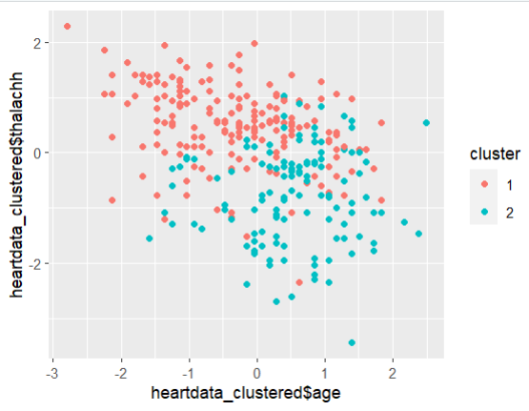

K-means clustering
Modeling Techniques (2) Model Training
#Exploring data with 0,1 values as they won't be of much help in making the clusters
heartdata_c = heartdata[,-which(colnames(heartdata) %in% c("sex","fbs","exng","output"))]
# Standardize the dataset and apply K-means clustering
heartdata_scale = scale(heartdata_c)
km <- kmeans(heartdata_scale, centers = 2, nstart = 10)
heartdata_clustered <- as_tibble(heartdata_scale) %>% add_column(cluster = factor(km$cluster))
ggplot(heartdata_clustered,aes(x=heartdata_clustered$age,y = heartdata_clustered$thalachh, color = cluster)) + geom_point()
#actual output
ggplot(heartdata, aes(x = heartdata$age, y = heartdata$thalachh, color = heartdata$output)) + geom_point()
Accuracy = 0.78
Notes:
Train the Model: Split the dataset into training and testing sets. Use the training set to train the chosen model on the data.

